Slide 1

EXAMPLES OF DO WHILE..LOOP
Example 1 : Never executes loop
Dim A as Integer
A=10
Do While A>10
A=A-1
Loop
Example 2 : Executes loop
Dim P as Byte
P=10
Do While P>5
P=P-2
Loop

Slide 2
DO..LOOP WHILE
Do Loop While is an exit controlled loop as the condition is placed at exit point.
The body of the loop is going to be executed at least once whether the condition evaluates to true or false. Loop is executed as long as the result of the condition remains true.
Syntax :
Do
One or more VB Statements
Loop While <condition or Boolean Expression>

Slide 3
EXAMPLES
Example 1 :
Do
num = InputBox (“Enter a number”)
sum = sum + num
Loop While num < > 0
Here the statements inside the loop will be executed once no matter what the comparison test evaluates to.

Slide 4
DO..UNTIL LOOP
Do Until loop is an entry controlled loop in which the condition is placed at the entry point.
This loop executes the statements specified in the body of the loop till the condition evaluates to false.
The loop may not be executed at all the if the condition is initially true.
Syntax :
Do Until <condition or boolean expression>
‘ One or more VB Statements
Loop

Slide 5
EXAMPLES OF DO UNTIL..LOOP
Do Until condition
//statement
Loop

Slide 6
DO..LOOP UNTIL
Do Loop Until is an exit controlled loop as the condition is placed at exit point.
The body of the loop is going to be executed at least once whether the condition evaluates to true or false.
Loop is executed as long as the result of the condition remains false.
Syntax :
Do
One or more VB Statements
Loop Until <condition or Boolean Expression>

Slide 7
EXAMPLES
Example 1 :
Do
num = InputBox (“Enter a number”)
sum = sum + num
Loop Until num = 0
Here the statements inside the loop will be executed once no matter what the comparison test evaluates to.

Slide 8
WHILE..END WHILE
While..Wend loop is functionally equivalent to the Do While..Loop. It executes a set of VB statements till the condition evaluates to true.
Syntax :
While <Condition>
one or more vb statements
End While

Slide 9
EXAMPLE
Example 1 : Generate the sum of first 10 natural no’s
I = 1
While I<=10
Sum = Sum + I
I = I + 1
End While
MsgBox(“Sum of 10 natural no’s = ” ; Sum)

Slide 10
FOR EACH…NEXT
Syntax:-
For Each Element [As Data Type] In Group
‘one or more statements
Next [Element]
Example:-
Dim strEmployees As String() = {"Jim", "Sally", _
"Henry", “Tom", “Jack"}
Dim strName As String
For Each strName In strEmployees
MessageBox(strName)
Next strName

Slide 11
WITH...END WITH
It executes a series of statements making repeated reference to a single object or structure.
We can use a With...End With structure to specify the object once for all of the statements.

Slide 12
Syntax:-
With <object name>
.<property-name>=<value>
..
.<property-name>=<value>
End With
Example:-
With testObject
.Height = 100
.Text = "Hello World"
.ForeColor = System.Drawing.Color.Green
End With

Slide 13
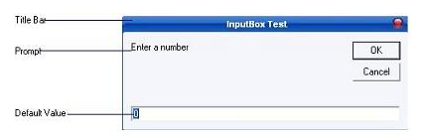
INPUTBOX METHOD
Displays a prompt in a dialog box, waits for the user to input value in textbox and button click, and then returns a value containing the contents of the text box.
Following is an expanded InputBox:-

Slide 14
Syntax :
variable-Name= InputBox(prompt[,title][,default][,XPos][,YPos)
Prompt - String expression displayed as the message in the dialog box. If prompt consists of more than one line, you can separate the lines using the vbCrLf constant
Title - String expression displayed in the title bar of the dialog box. If you omit the title, the application name is displayed in the title bar
default-text - The default text that appears in the input field where users can use it as his intended input or he may change to the message he wish to key in.

Slide 15
Xpos- Optional. Numeric expression that specifies, in twips, the distance of the left edge of the dialog box from the left edge of the screen. If you omit XPos, the dialog box is centered horizontally.
Ypos- Optional.Numeric expression that specifies, in twips, the distance of the upper edge of the dialog box from the top of the screen. If you omit YPos, the dialog box is positioned vertically approximately one-third of the way down the screen.

Slide 16
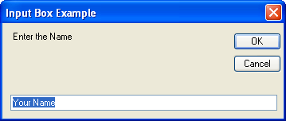
EXAMPLE
InputBox("Enter the Name", "Input Box Example", "Your Name")

Slide 17
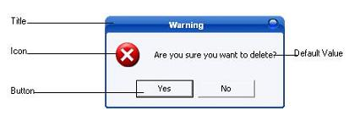
MSGBOX & MESSAGEBOX.SHOW METHOD
Displays a message in a dialog box and wait for the user to click a button, and returns an integer indicating which button the user clicked.

Slide 18
The message box function you have used so far is the old message box function. It is the one left over form VB6:
MsgBox("Your Message Here")
The new VB.NET message box function is very similar, but the way you use it is slightly different. It's this:
MessageBox.Show("Your Message Here")

Slide 19
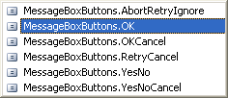
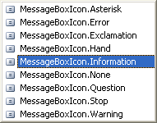
Syntax :
MessageBox.Show ( Prompt [,icons + buttons ] [,title ] )
Prompt : String expressions displayed as the message in the dialog box. If prompt consist of more than one line, you can separate the lines using the vbrCrLf constant.
Icons + Buttons : specifying the type of buttons and icon to display.

Slide 20
Title : String expression displayed in the title bar of the dialog box. If you omit title, the application name is placed in the title bar.
In a real programme, you should use the new MessageBox.Show( ) function, rather than the MsgBox() we used (and will again because it saves on typing and space!)

